Slide 1
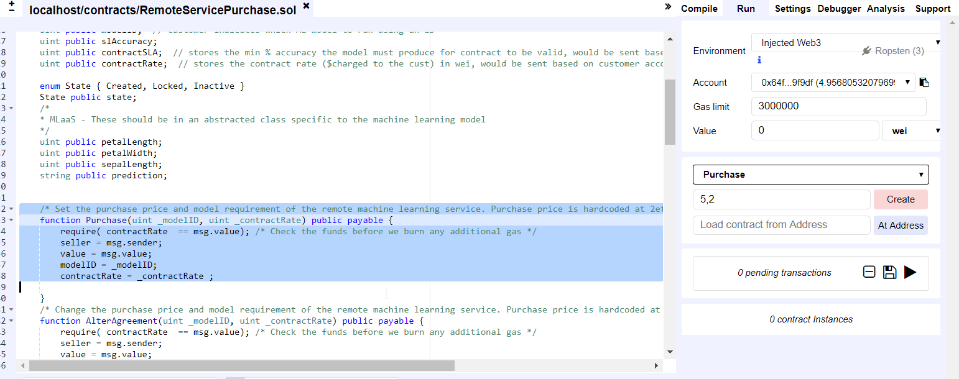
1. Publish RemoteServiceContract with contract rate and machine learning model ID. This calls the constructor. Create and sign the request. Wait for the contract to be mined, then retrieve the contract address.
https://ropsten.etherscan.io/address/0xc1d76a5077080171df882a05e267d987fa576063

Slide 2
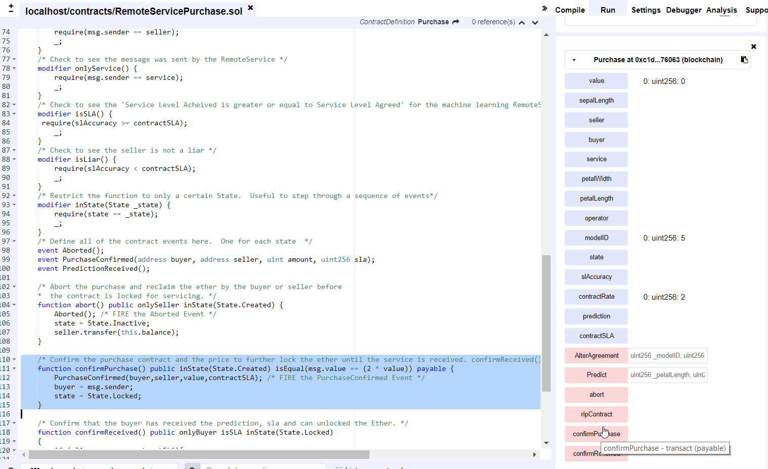
2. Execute the confirmPurchase and agree to the contract terms and price. Sign the transaction.
[block:2286817 txIndex:1] from:0x64f...9f9df, to:Purchase.confirmPurchase() 0xc1d...76063, value:0 wei, 1 logs, data:0xd69...60697, hash:0x080...f4f89

Slide 3
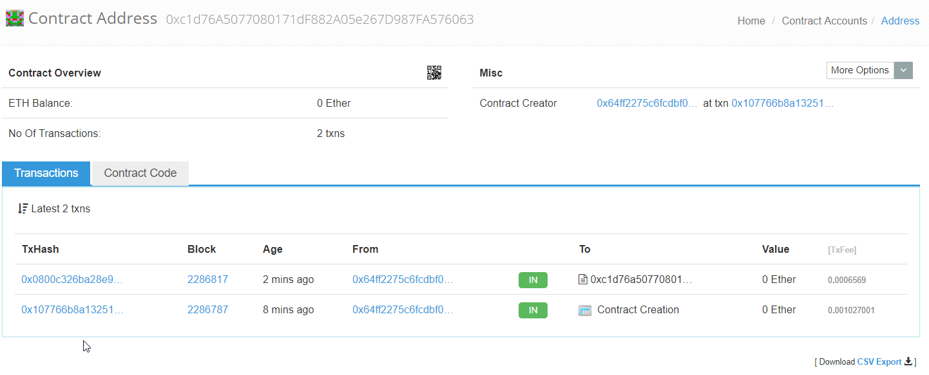
3. Can check the account on Etherscan to see the contract was deployed and the corresponding transaction information.
https://ropsten.etherscan.io/address/0xc1d76a5077080171df882a05e267d987fa576063

Slide 4
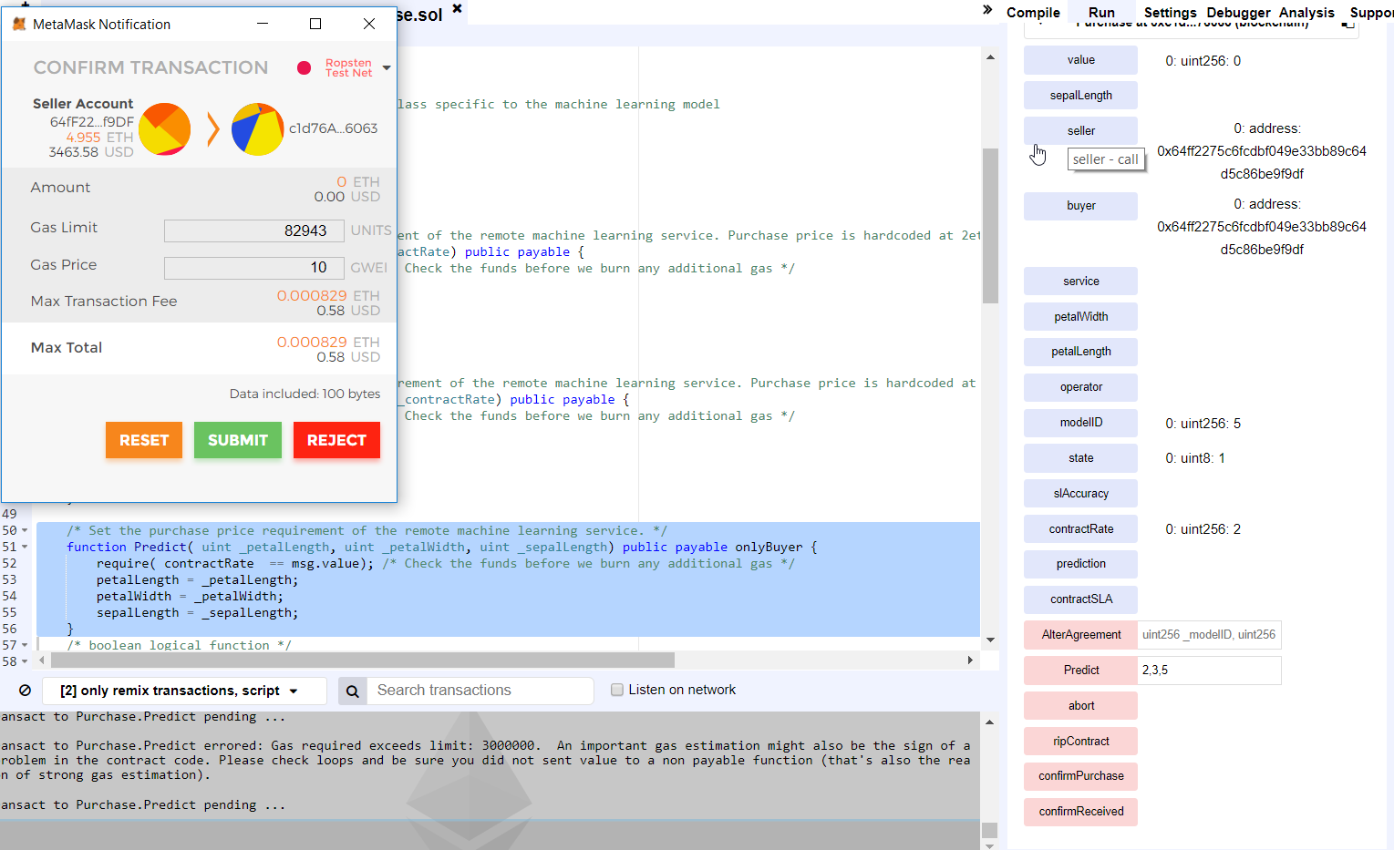
4. Execute the Predict function and enter the ML Model parameters. For this example enter the petal length, width, and sepal length. Also send the amount of Wei specified by contractRate (2 Wei)

Slide 5
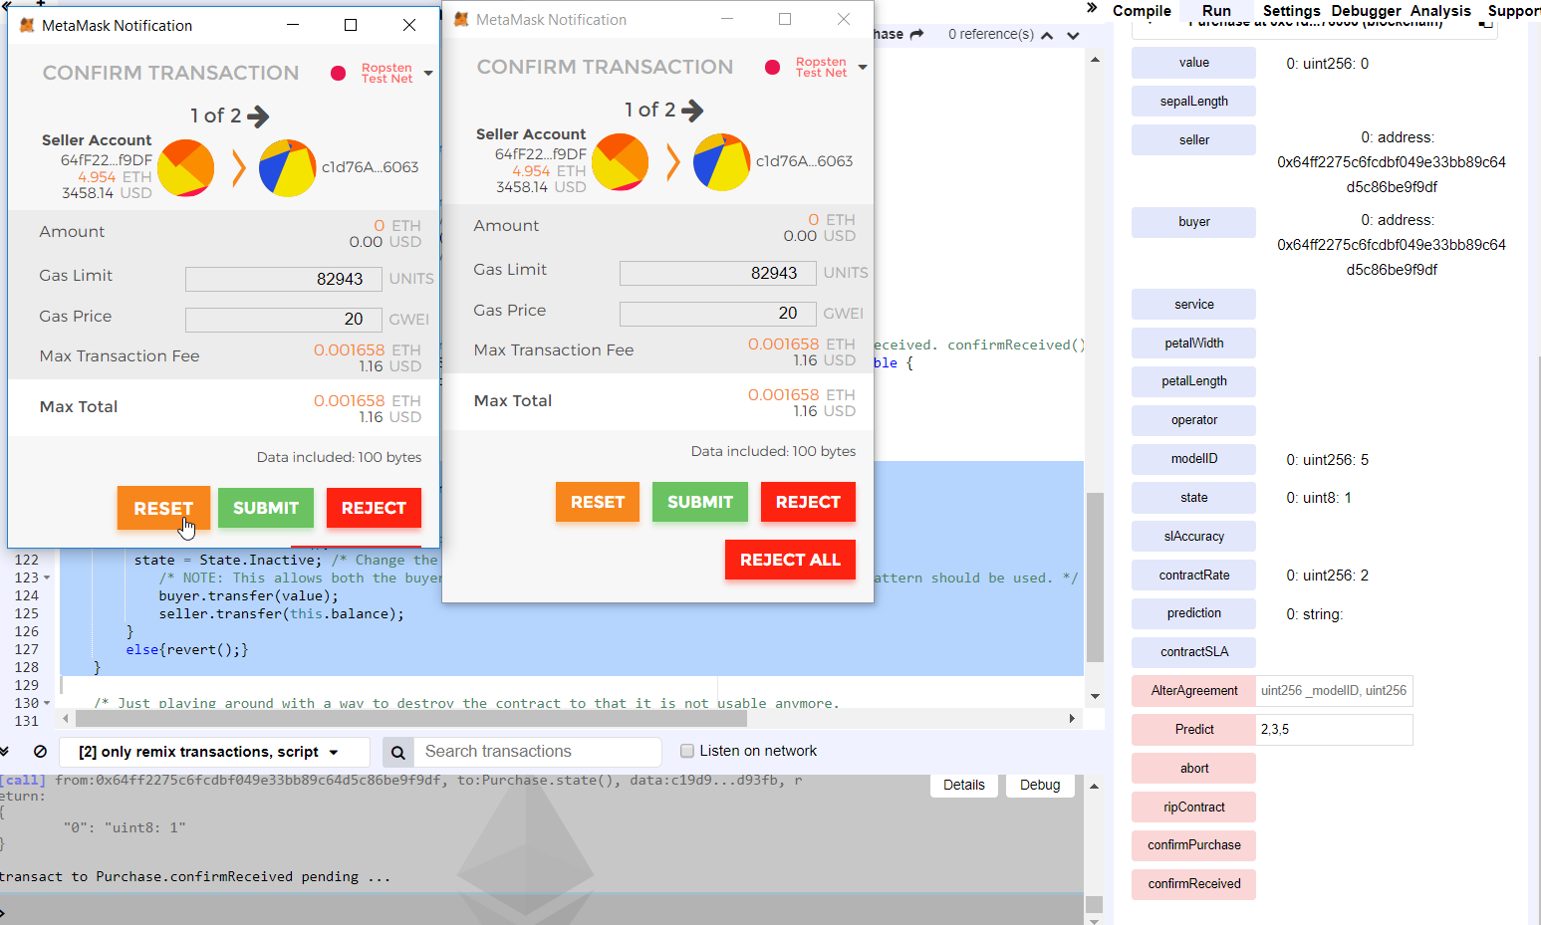
5. Execute the confirmReceived function. Confirm the purchase was received by signing two transactions. The funds will be transferred and the state of the contract changed to 2. completed.

Slide 6
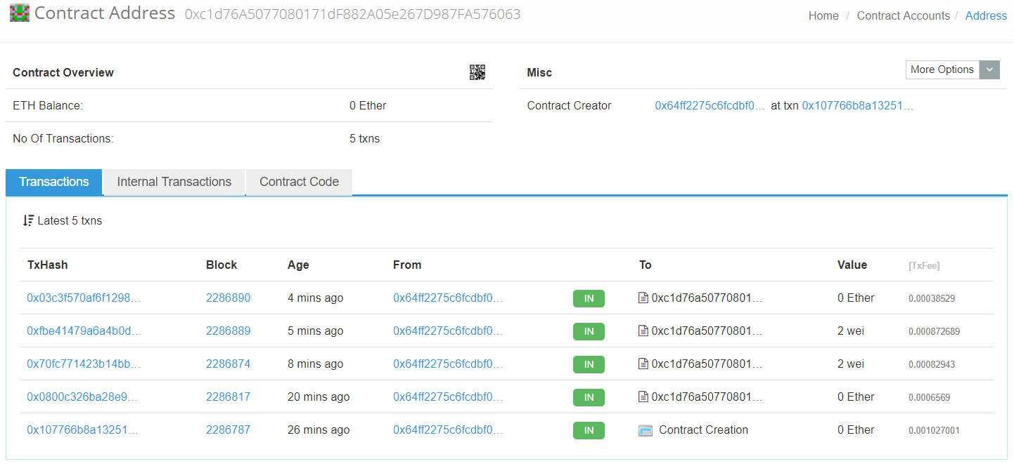
6. Can check the account on Etherscan to see the contract was executed and the corresponding transaction information.
https://ropsten.etherscan.io/address/0xc1d76a5077080171df882a05e267d987fa576063

